Slide 1


DC–HSPA+ Technology

Slide 2

Content
Mobile Broadband Evolution
CDMA Concepts
WCDMA
What is HSDPA?
From HSDPA to HSPA+
What is DC-HSPA+ ?
Beyond DC-HSPA+

Slide 3

Mobile Broadband Evolution

Slide 4

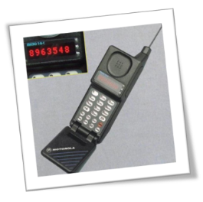
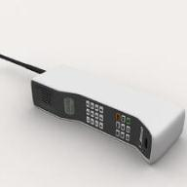
Only Walking
Analog Phones
By Foot
Voice calls only
Devices
Services
Type
Narrow Road
Narrow Band
1G
25kHz

Slide 5

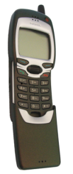
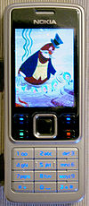
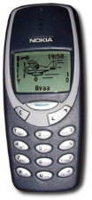
Evolution (Cont..)
Speed Travel
Digital phones
Cart/ Vehicle
Voice/ SMS
Devices
Services
Type
Wide
Wider than prev.
2G
200kHz
Data
GPRS/EDGE
384kbps (max)
2.5G

Slide 6

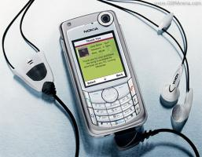
Evolution (Cont..)
UMTS
Data Rates Targets
Universal Mobile Telecommunication System
WCDMA
2 Mbps for fixed wireless
384 Kbps for pedestrian
144 Kbps for vehicular traffic
3G
5MHz

Slide 7
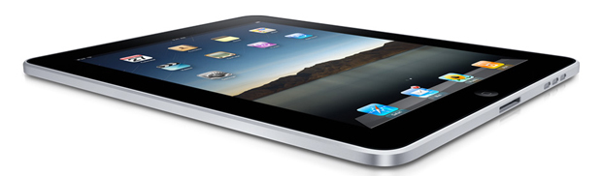
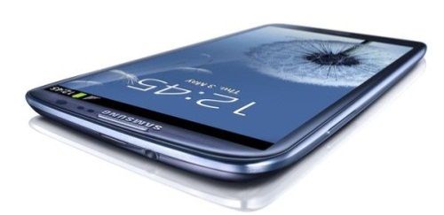
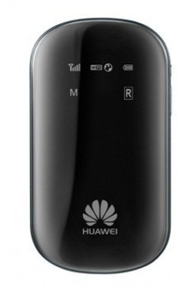
Evolution (Cont..)
3.5G HSPA
3.75G HSPA+
High Speed Downlink Packet Access (HSDPA) – 14.4Mbps
Download Speed - 21 Mbps
High Speed Uplink Packet Access (HSUPA) – 5.76Mbps
Upload Speed – 5.76 Mbps
DC-HSPA+
Download Speed - 42 Mbps
Upload Speed – 5.76 Mbps
Dual Carrier HSPA+
3G
3.5G
3.75G
5MHz
5+5 MHz

Slide 8
Mobile Broadband Technology Evolution
High Speed Packet Access Plus
Enhanced Data Rates for GSM Evolution
High Speed Downlink Packet Access
Dual Carrier High Speed Packet Access Plus
Wideband Code Division Multiple Access
HSPA = HSDPA + HSUPA
(HSUPA= High Speed Uplink Packet Access)
General Packet Radio Service
 | GSM/ GPRS | EDGE | WCDMA | HSDPA | HSPA | HSPA+ | DC-HSPA+
Release | R’96/97 | R’98 | 3GPP R’99 | 3GPP R5 | 3GPP R6 | 3GPP R7 | 3GPP R8
Max Theoretical DL speed | 171kbps | 384kbps | 2Mbps | 14.4Mbps | 14.4Mbps | 21Mbps | 42Mbps
Max Theoretical UL speed | 14kbps | 14kbps | 384kbps | 384kbps | 2Mbps | 5.76Mbps | 5.76Mbps
Notes:
Mobile Broadband evolved from 2G (EDGE) to 3G.
3G had different versions, from 3GPP R99 to R7, and as Etisalat we launched 3G in 2011 with HSPA+ with 3GPP - R7 network.
It was very easier for us to upgrade it to next release since we had to latest equipment's, due to late entry to the market.
So now we have upgrade all our 3G elements to DC-HSPA+.

Slide 9

CDMA Concepts

Slide 10
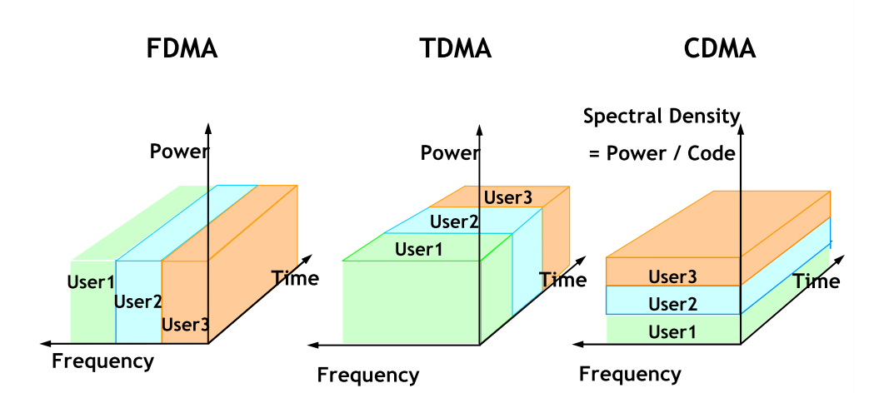
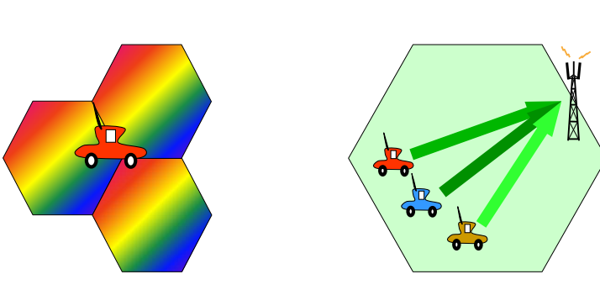
CDMA : Full BW, All the time
But…
Not full RF power.
One Frequency in all the Cells
Freq. Reuse Factor = 1
Entire BW used by each user at the Same time

Slide 11
Spreading Operation
How to Differentiate Cells and Users ?
Channelization Codes (SF)
Scrambling Codes
Data
Data Rate
Chip Rate
Chip Rate
Channelization codes : Increases Signal BW ; Uses Orthogonal codes
Scrambling codes : Does not Increase Signal BW ; Uses Pseudo noise codes
Notes:
SF = Chip Rate/Symbol Rate
Symbol Rate : HIGH => SF : LOW
Symbol Rate : LOW => SF : HIGH
Eg: Voice 12.2kbps SF =>128

Slide 12
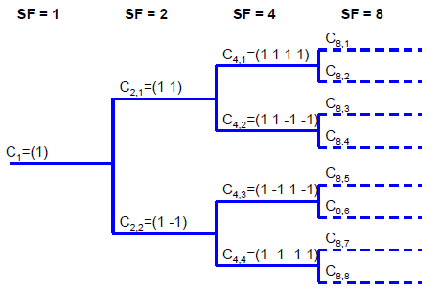
Channelization Codes….
Based on OVSF (Orthogonal Variable Spreading Factor) code tree
Differentiate users within a sector
Notes:
White board

Slide 13

Scrambling Codes….
Scrambling Code
What If Two Sectors use the same OVSF code ?
OVSF Code Tree
Notes:
Gold codes are used for Scrambling codes
512 SC for DL. For each cell there is a Scrambling code

Slide 14
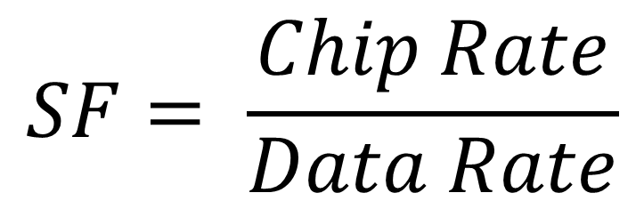
What is “Spreading Factor” ?
Also Known as Processing Gain
$$SF= \frac{Chip Rate}{Data Rate}$$
Q). For a 12.2kbps Voice call what is the required SF ?
(Chip Rate : 3.84 Mcps)

Slide 15

WCDMA (R’99)

Slide 16


Dedicated Channel (DCH)
5MHz carrier
(Chip Rate : 3.84Mcps)
Transmission Time Interval (TTI) : How frequently data is transmitted to user. TTI : 10ms
Modulation : QPSK
Retransmission and Scheduling : RNC
Notes:
Physical channel is a code
Direct sequence Spread spectrum

Slide 17

What is HSDPA ?

Slide 18
No Dedicated Channels any more
High speed Shared Channel
TTI :
10ms
2ms
Adaptive Modulation (QPSK and 16 QAM) and Coding
Retransmission and Scheduling
RNC
NodeB
Notes:
Channel coding : Turbo Coding
Hopping Spread spectrum

Slide 19
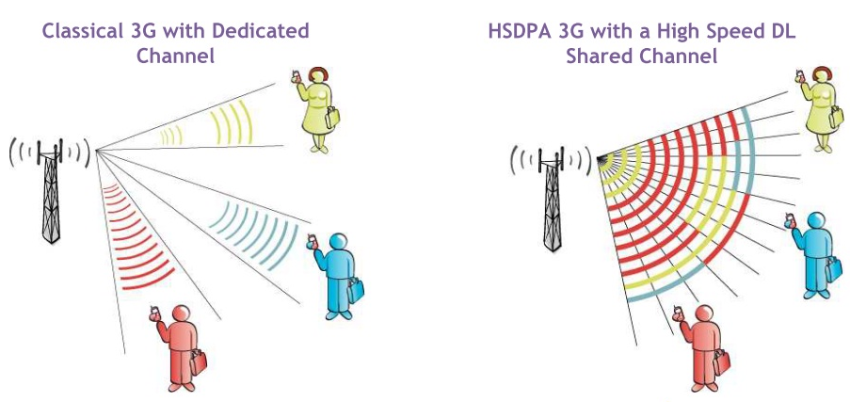
Dedicated Channel Vs Shared Channel
Shared Channel is much more efficient than a dedicated channel to carry bursty Packet traffic

Slide 20
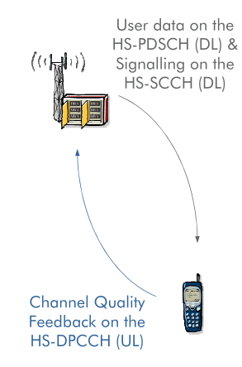
High Speed Downlink Shared Channel (HS-DSCH)
Transport channel used mainly for data transmission.
Contains three main Physical layer channels
HS – PDSCH : For DL data tx.,Up to 15 codes, SF 16
HS – SCCH : For DL control info. Tx., Up to 4 codes, SF 128
HS – DPCCH : For UL tx. (CQI, ACK/NACK), SF 256

Slide 21


Resource Sharing in HSDPA…..
Codes
Time
2ms TTI
2ms TTI
2ms TTI
2ms TTI

Slide 22
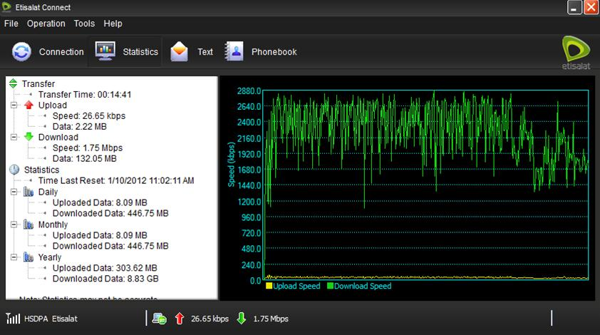
An Example of throughput reduction with number of users…..

Slide 23
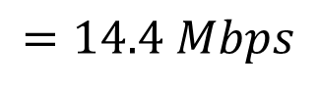
HSDPA DL speed 14.4Mbps ?
$Data Rate per HS−PDSCH code= \frac{Chip Rate }{SF} = \frac{3.84 Mcps}{16}$
$$Max. no of available HS−PDSCH codes =15$$
$$Max. DL throughput with 16 QAM modulation = \frac{3.84 Mcps}{16}x15x4$$
$$=14.4 Mbps$$

Slide 24
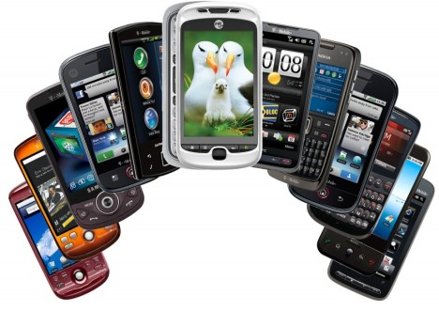
From HSDPA to HSPA+ ……

Slide 25
High Speed Packet Access - HSPA
HSDPA + HSUPA
HSUPA : Designed to increase the uplink throughput over the air interface
Theoretical peak user bit rate : 5.76 Mbps
Enhanced Dedicated Channel (E-DCH) in UL
Notes:
E-DCH : UL dedicated transport channel
TTI : 10 or 2ms
Shared resource is the RoT. Node B controls the allocation of this margin. Select best TFC for a given UE according to the interference margin

Slide 26
Q). Calculate the max. possible throughput that can be achieved with HSPA+
HSPA+ (Rel.7)
Modulation :
16 QAM, QPSK
64 QAM

Slide 27

What is Dual Carrier - HSPA+ ?
(DC-HSPA+)

Slide 28


HSPA+ Vs DC-HSPA+….
Single Stream
Dual Streams

Slide 29
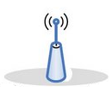

HSPA+ vs DC-HSPA+….
With HSPA+,
Users are served using only one carrier
DC-HSPA+,
two carriers have been aggregated together to provide high speeds to users
f1
f1
f2
HSPA+
DC -HSPA+
f1, f2 : 5MHz carriers

Slide 30

About Two carriers……
Anchor Carrier : Both UL and DL
Supplementary Carrier : Only for DL

Slide 31
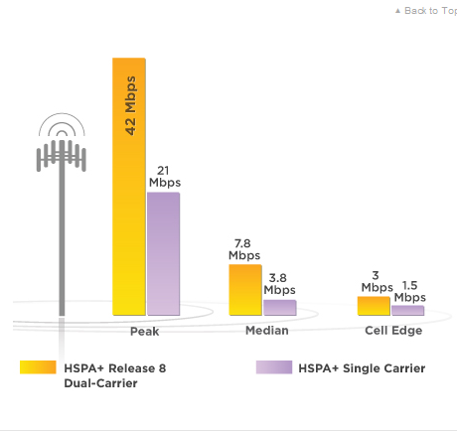
DC-HSPA+….
Doubles Speed
Throughout
the cell.
Notes:
Everywhere the speeds will be doubled.
For this we need to have DC-HSPA+ enable device.
Everyone will be benefited.

Slide 32
Other Advantages :
HSDPA Carrier load balancing : High Radio Resource usage efficiency
DC-HSPA+ is backward compatible with earlier Releases of 3G (R’99, Rel.5, Rel.6 and Rel.7)
High Spectrum efficiency

Slide 33
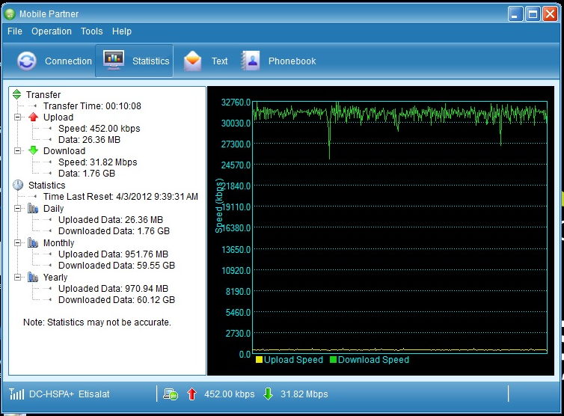
DC-HSPA+ Test Results
Peak Throughput
32Mbps
@ Rotunda Tower.
Notes:
Achieving higher speeds are not possible with day-to-day applications.
Eg: 1.5Mbps is sufficient for applications like FB, YouTube
To achieve above results we had to do parallel 10-15 FTP downloads.

Slide 34


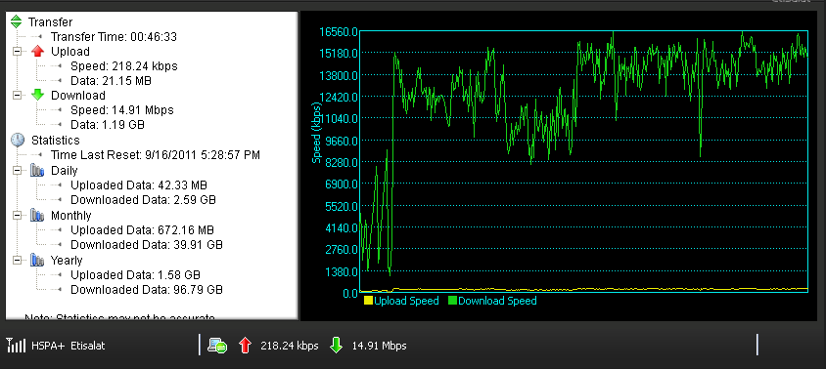
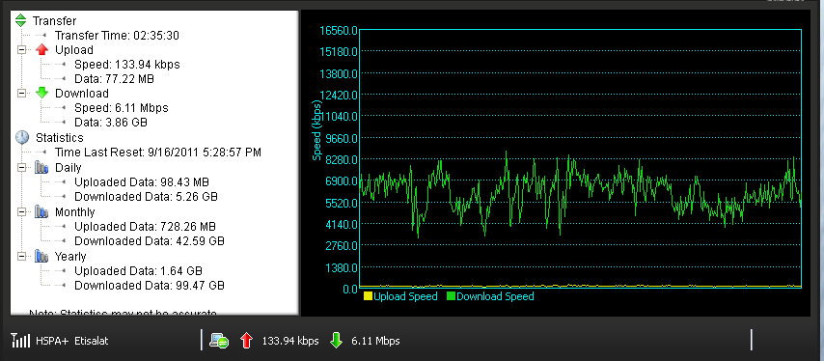
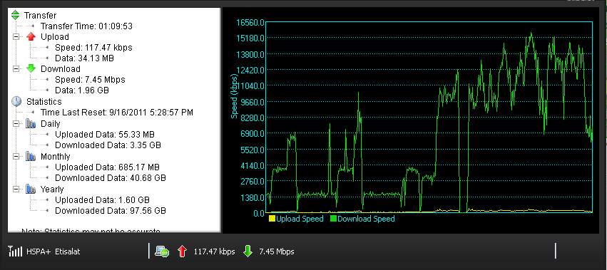
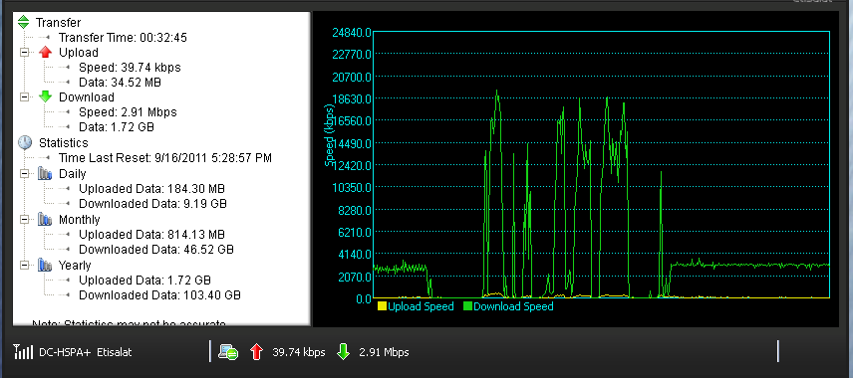
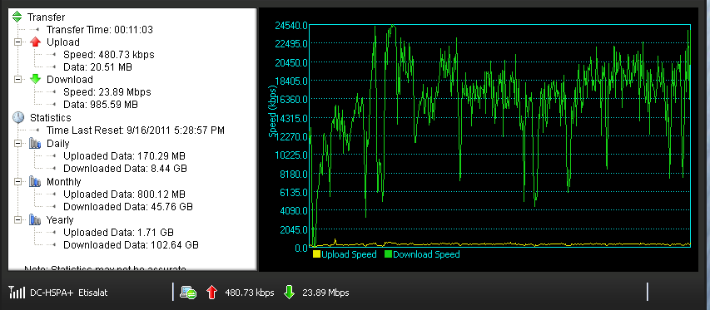
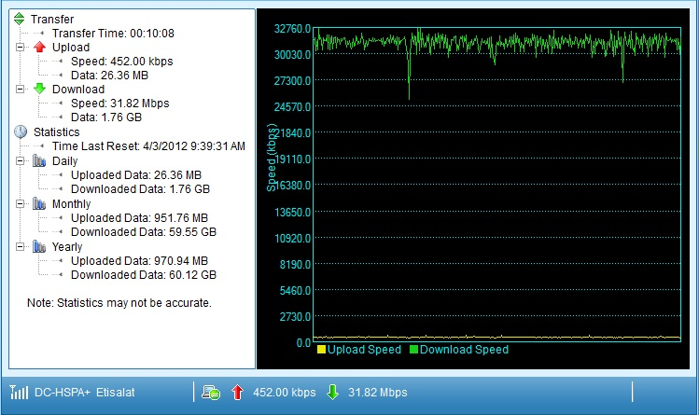
YouTube :
From Local File Server :
Torrentz :
15.1Mbps
8.2 Mbps
HSPA+
DC -HSPA+
16.5Mbps
18.6Mbps
32.7 Mbps
24.5Mbps

Slide 35
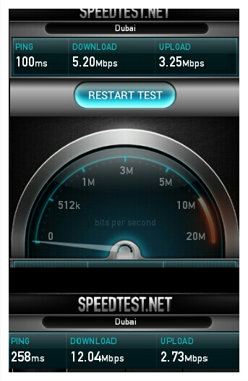
Test Results from BagathaleRd
With HSPA+
Speed Doubled!
With DC -HSPA+
Notes:
- Simply the speeds will doubled

Slide 36
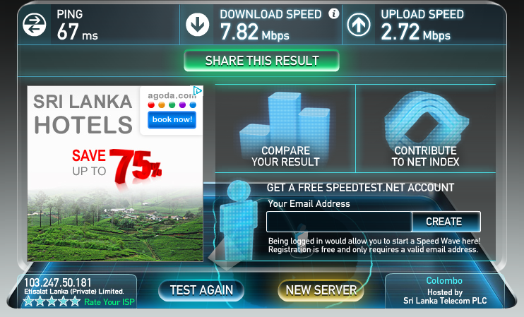
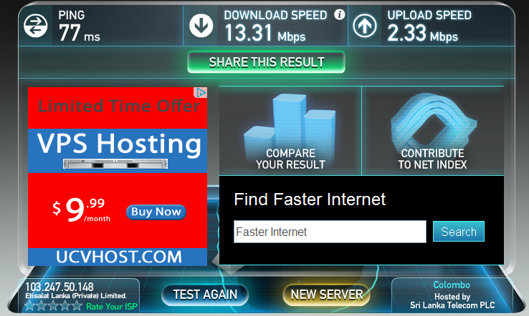
Test Results at Malabe
With HSPA+
With DC -HSPA+
Speed Doubled!

Slide 37
Can all of us archive these higher Speeds, beyond 21Mbps ??
Need to have DC-HSPA+ capable device with correct APN
Need to use a application which need this much of higher data rates
Eg: Will not get high speed by watching HD Youtube
The server side also need to have the capability to support higher speed
Eg: Torrent download can have limitation from sever side
Dongle, phone, Tab WiFi router
No improvement on UL with this technology

Slide 38
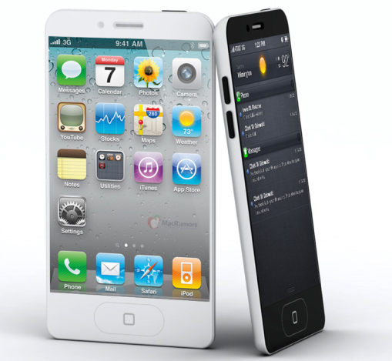
Why 32 Mbps max?
42 Mbps is the Theoretical max. achievable in Physical Layer
No of Codes used : 14
Radio Conditions

Slide 39

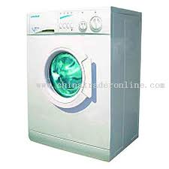

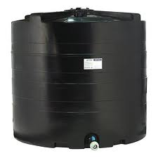
Different customers - different Requirements

Slide 40






What Speeds Customers Need
5Mbps,
Higher the better
Depend on seeds
300kbps, 700kbps, 1.5Mbps
500 kbps
100kbps
100kbps
400 kbps
Notes:
In other terms we have double the capacity

Slide 41
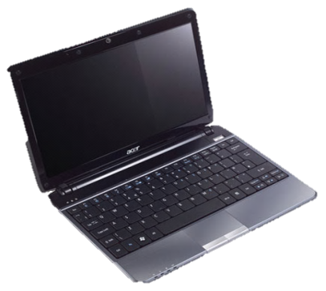
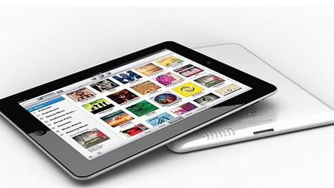
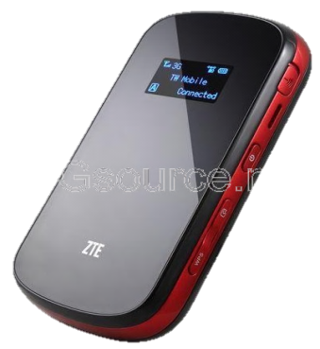
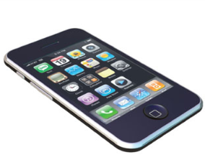

What we can do with DC-HSPA+ ?
Doubling
Better user experience
High Capacity
Sharing
One connection can cater the data demand of a family or a SME
Notes:
-.MF80 Router supporting
-.Most of the applications require little amount of data. Hence to get the max. use of DC-HSPA+, it can be used in SME with a Wi-Fi router to connect several users

Slide 42
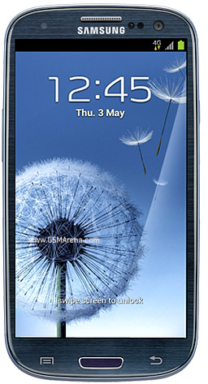

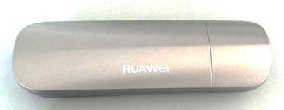
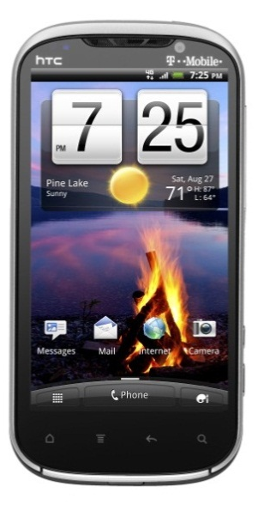
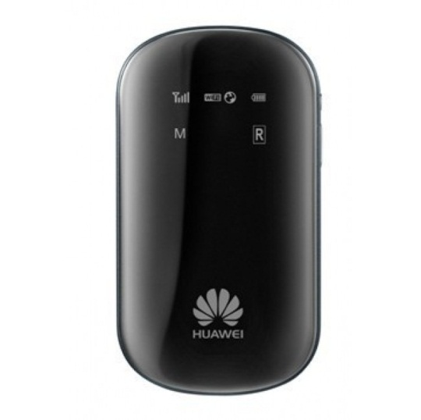
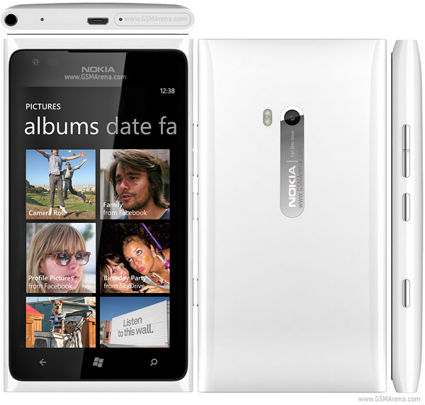
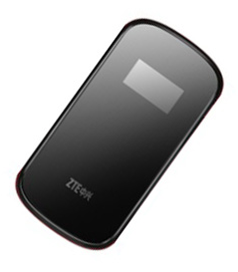
DC-HSPA+ Capable Devices
E 372
E 587
ZTE MF80

Slide 43
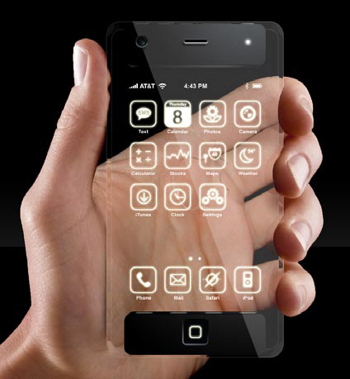
Beyond DC-HSPA+ ….

Slide 44
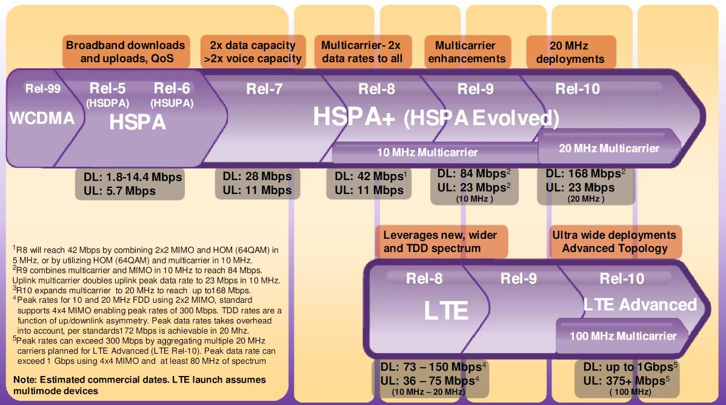
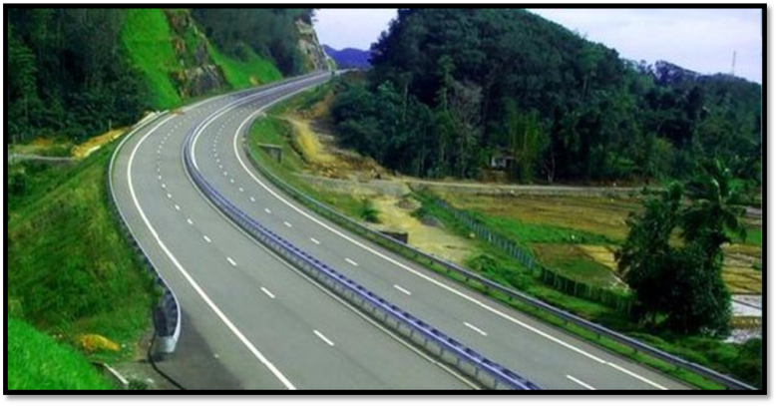
4G

Slide 45

Future of Mobile Broadband…..
High-Definition Telepresence
Telemedicine and Remote Surgery
Video Instant Messaging and Video Presence
High-Definition Television
Real-Time Data Backup
Notes:
1.High-Definition Telepresence: This could be Cisco’s product or another setup from a different vendor. The point is this: high-definition telepresence requires 24 Mbps and about a 50 millisecond latency to recreate the feeling of sitting in a room speaking with people. Maybe it’s a luxury, but the travel savings and potential business deals that could be struck using such systems are impressive. Companies such as Shangby, which is using standard video to sell jewelry from China, would benefit from faster bandwidth that would allow them to show their products in HD.
2.Telemedicine and Remote Surgery: Sure, it’s the stuff of science fiction, but rural doctors have been sending medical images to doctors overseas for years. The next step is surgery done by robots or other doctors in consultation with remote physicians. Given the delicate nature of the job, this is a task that requires 10 Mbps and 1 millisecond latency for surgery.
3.Video Instant Messaging and Video Presence: This one isn’t even close to reality and requires speeds of 10 Mbps on mobile networks (which won’t happen until we get LTE and fiber backhaul), but firms including NTT DoCoMo are working on the concept of having always-on video connectivity.
4.High-Definition Television: Depending on compression algorithms and the network equipment, HD TV requires between 8 and 5 Mbps to deliver crisp video to consumer’s televisions.
5.Real-Time Data Backup: This isn’t for those of us concerned about family photos — its aimed at Wall Street traders and businesses worried about interruptions to their operations and keeping their data secure. Such efforts require speeds of up to 2 Mbps and 10 milliseconds of latency, and they may become more necessary as enterprises begin to store and save data in the cloud.

Slide 46
THANK YOU

Slide 47
Demonstration

